Slide 1
Module-4

Slide 2
In real life problems, two-class datasets are only rarely linearly separable. In such a case we introduce additional variables, ξ_{i}, called slack variables which store deviations from the margin.
There are two types of deviation: An instance may lie on the wrong side of the hyperplane and be misclassified.
Or, it may be on the right side but may lie in the margin, namely, not sufficiently away from the hyperplane.
This method of finding the hyperplane including slack variable is called soft margin hyperplane of the SVM problem

Slide 3
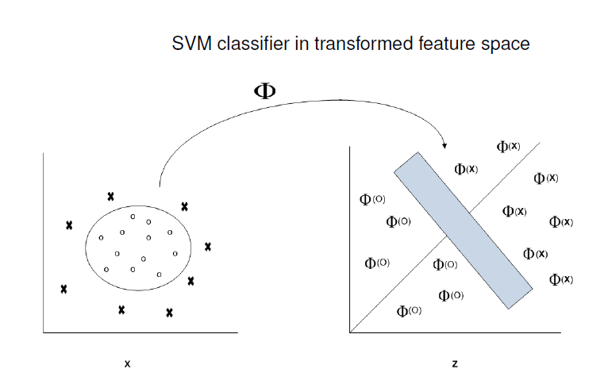
Non-Linearly Separable Data
There are two main steps for nonlinear generalization of SVM. The first step involves transformation of the original training (input) data into a higher dimensional data using a nonlinear mapping. Once the data is transformed into the new higher dimension, the second step involves finding a linear separating hyperplane in the new space. The maximal marginal hyperplane found in the new space corresponds to a nonlinear separating hypersurface in the original space.

Slide 4

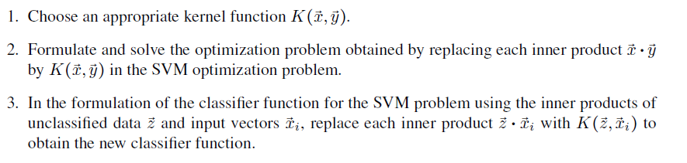
  The kernel method (kernel trick)
For a non-linear data SVM finds it difficult to classify the data. The easy solution is to use the kernel trick. A kernel trick is a simple method , where a non-linear data is projected into a higher dimensional space so as to make it easier to classify the data where it could be linearly divided by a plane. This is mathematically achieved by Lagrangian formula using Langrangian multiplier

Slide 5
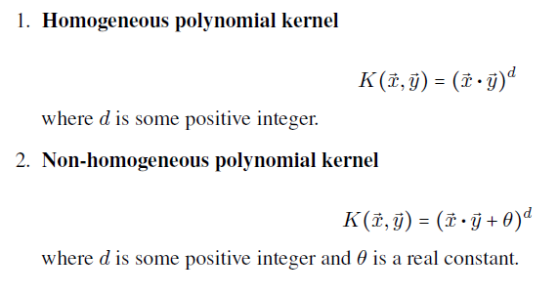
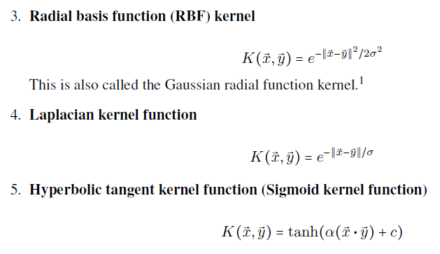
Some important kernel functions

